Slide 1
Model validation and selection
Stephanie J. spielman, phd
bio5312, Fall 2017

Slide 2
Recall our models
Linear models
Logistic regression

Slide 3
Model validation and selection
Model Validation
What approaches can we use to evaluate the performance of a model?
What metrics can we use to measure model performance?
Model Selection
Given a set of possible models, how do we choose the "best" one?
How do we choose predictors, in particular main vs. interaction effects?
What metrics can we use to compare model performance?

Slide 4
Evaluating logistic regressions
> model <- glm(outcome ~ ., data=biopsy, family=binomial)
> new.patient <- tibble(clump_thickness = 4,
uniform_cell_size = 2,
uniform_cell_shape = 7,
marg_adhesion = 3,
epithelial_cell_size = 8,
bare_nuclei = 1,
bland_chromatin =5,
normal_nucleoli = 2,
mitoses = 0)
> predict(model, new.patient, type = "response")
1
0.2875157

Slide 5
Confusion matrix and emerging quantities
TRUTH
 | Positive (True) | Negative (False)
Positive (True) | Type I error (False positive) | True positive
Negative (False) | True negative | Type II Error (False negative)
PREDICTION

Slide 6
Confusion matrix on the biopsy model
False positive
True positive
True negative
False negative

Slide 7
Emerging quantities
TRUTH
 | Positive (True) | Negative (False)
Positive (True) | Type I error (False positive) | True positive
Negative (False) | True negative | Type II Error (False negative)
PREDICTION
True Positive Rate aka Sensitivity or Recall
TPR = TP/P = TP/(TP+FN)
False Positive Rate
FPR = FP/N = FP/(FP+TN) = 1 – TNR
True Negative Rate aka Specificity
TNR = TN/N = TN/(FP+TN)
Precision aka Positive Predictive Value (PPV)
TP/(TP+FP)
False discovery rate
FP/(FP+TP) = 1– PPV
Accuracy
(TP + TN) / (TP + TN + FP + FN)

Slide 8
Calculate these qualities for biopsy model
> model <- glm(outcome ~ ., data=biopsy, family=binomial)
### Remove outcome from biopsy dataset, so we can predict from dataset
> biopsy %>% select(-outcome) -> biopsy.naive
### Predict all the rows
> predict(model, biopsy.naive, type = "response") %>% as.data.frame()
.
1 0.0160465814
2 0.9088086224
3 0.0081376226
4 0.7609349192
5 0.0181668485
6 0.9999736224
...

Slide 9
Calculate these qualities for biopsy model
> biopsy2 <- biopsy %>%
mutate(pred = predict(model, biopsy.naive, type = "response") )
### Let's say >0.5 is a prediction of malignancy ###
> biopsy2 %>%
mutate(pred.malignancy = ifelse(pred > 0.5, "mal","benign")) %>%
group_by(outcome, pred.malignancy) %>%
tally()
outcome pred.malignancy n
<fctr> <chr> <int>
1 benign benign 434
2 benign mal 10
3 malignant benign 11
4 malignant mal 228
true negative
false positive
false negative
true positive

Slide 10
Evaluating the classifier
outcome pred.malignancy n
<fctr> <chr> <int>
1 benign benign 434
2 benign mal 10
3 malignant benign 11
4 malignant mal 228
true negative
false positive
false negative
true positive
TPR = TP / (TP + FN) = 228 / (228 + 11) = 0.953
FPR = FP / (FP + TN) = 10 / (10 + 434) = 0.023
TNR = 1 – FPR = 0.977
PPV = TP / (TP + FP) = 228/(228 + 10) = 0.957
Acc = (TP+TN) / (total) = (228 + 434) / (683) = 0.969

Slide 11
What about for any possible cutoff?
Receiver Operating Characteristic (ROC) curves are a common tool to diagnose the ability of a binary classifier
Quantify with metric AUC
Area Under the Curve (literally)
0.5 = random classification
1 = perfect classification
TPR = Sensitivity
FPR= 1 - Specificity

Slide 12
ROC and AUC for our biopsy model
> library(pROC) ### You will have to install this packages
> roc.object <- roc(biopsy$outcome, model$linear.predictors)
> roc.object$auc
Area under the curve: 0.9963

Slide 13
Visualize the ROC curve
> roc.data <- tibble(x = roc.object$specificities,
y = roc.object$sensitivities)
> ggplot(roc.data, aes(x = x, y = y)) +
geom_line() + scale_x_reverse() +
ylab("Sensitivity") +
xlab("Specificity") +
abline(color="red")

Slide 14
Model selection via AUC
> tidy(model)
term estimate std.error statistic p.value
1 (Intercept) -10.103942243 1.17487744 -8.59999681 7.971831e-18
2 clump_thickness 0.535014068 0.14201743 3.76724220 1.650608e-04
3 uniform_cell_size -0.006279717 0.20907739 -0.03003537 9.760388e-01
4 uniform_cell_shape 0.322706496 0.23060065 1.39941710 1.616879e-01
5 marg_adhesion 0.330636915 0.12345089 2.67828703 7.399977e-03
6 epithelial_cell_size 0.096635417 0.15659236 0.61711452 5.371592e-01
7 bare_nuclei 0.383024572 0.09384327 4.08153469 4.473930e-05
8 bland_chromatin 0.447187920 0.17138238 2.60929928 9.072785e-03
9 normal_nucleoli 0.213030682 0.11287348 1.88734050 5.911454e-02
10 mitoses 0.534835631 0.32877389 1.62675821 1.037885e-01
> model1 <- glm(outcome ~ clump_thickness, data=biopsy, family=binomial)
> model2 <- glm(outcome ~ clump_thickness + marg_adhesion + bare_nuclei + bland_chromatin, data=biopsy, family=binomial)

Slide 15
Model selection via AUC
> model1 <- glm(outcome ~ clump_thickness, data=biopsy, family=binomial)
> roc1 <- roc(biopsy$outcome, model1$linear.predictors)
> roc1$auc
Area under the curve: 0.9089
> model2 <- glm(outcome ~ clump_thickness + marg_adhesion + bare_nuclei + bland_chromatin, data=biopsy, family=binomial)
> roc2 <- roc(biopsy$outcome, model2$linear.predictors)
> roc2$auc
Area under the curve: 0.9947

Slide 16
Directly compare ROC curves
> roc1.data <- tibble(x = roc1$specificities,
y = roc1$sensitivities,
model = "model1")
> roc2.data <- tibble(x = roc2$specificities,
y = roc2$sensitivities,
model = "model2")
> roc.both <- rbind(roc1.data, roc2.data)
> ggplot(roc.both, aes(x=x,y=y,color=model)) +
geom_line() + scale_x_reverse()

Slide 17
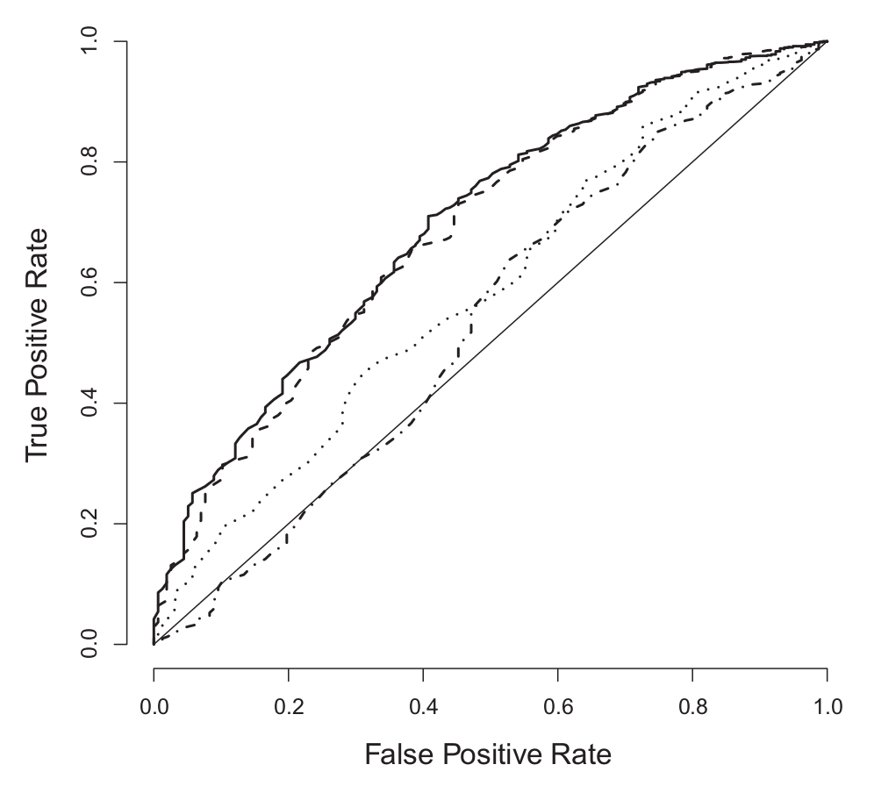
Real-life ROC curves
Keller, Mis, Jia, Wilke. Genome Biol. Evol. 4:80-88, 2012

Slide 18
Exercise break

Slide 19
Linear model selection and evaluation
Quantities of model fit (how well does my model fit the data?)
R²
Likelihood
Akaike Information Criterion (AIC)
Bayesian Information Criterion (BIC)
> model <- lm(Sepal.Length ~ Petal.Length, data = iris)
> glance(model)
r.squared adj.r.squared sigma statistic p.value df
1 0.7599546458 0.7583327177 0.407074548 468.5501535 1.038667419e-47 2
logLik AIC BIC deviance df.residual
1 -77.02021159 160.0404232 169.0723291 24.52503377 148

Slide 20
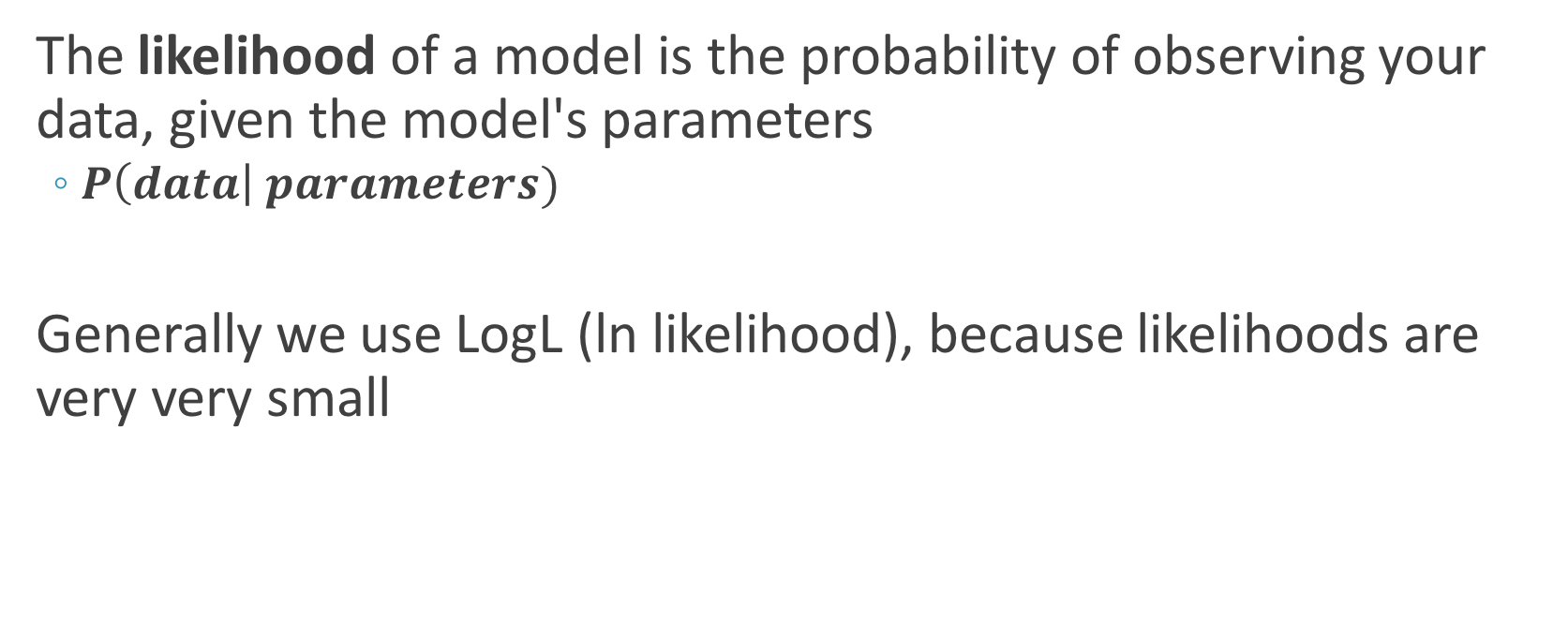
Likelihood
The likelihood of a model is the probability of observing your data, given the model's parameters
$P\left(data\right| parameters)$
Generally we use LogL (ln likelihood), because likelihoods are very very small

Slide 21

An example likelihood calculation
I flip a coin 500 times and get 380 heads, 120 tails. What is the likelihood of a model with p=0.5?
$$P\left(k successes\right)= \left({n \atop k}\right)p^{k}q^{(n−k)}$$
$P\left(380 successes | p=0.5\right)= \left({380 \atop 500}\right){0.5}^{380}{0.5}^{120}=$ 5.9e-30
LogL = ln(5.9e-30) = -74.21
> dbinom(380, 500, p=0.5)
[1] 5.9030476 e-33
> log(dbinom(380, 500, p=0.5))
[1] -74.209839
> dbinom(380, 500, p=0.5, log=T)
[1] -74.209839

Slide 22
Maximum likelihood estimation (simply)
Estimation approach to find the parameter value which maximizes the likelihood
> all.p <- seq(0, 1, by=0.01) #### 0, 0.01, 0.02,..., 0.99, 1.0
> all.logl <- dbinom(x=380, prob=all.p, size=500, log=T)
> p.logl <- tibble(x = all.p, y = all.logl)
> ggplot(p.logl, aes(x=x,y=y)) +
geom_line() +
xlab("Proportion p") +
ylab("LogL")
> p.logl %>% filter(y == max(y))
x y
<dbl> <dbl>
1 0.76 -3.176213056
The parameter value which maximizes the LogL is the MLE

Slide 23
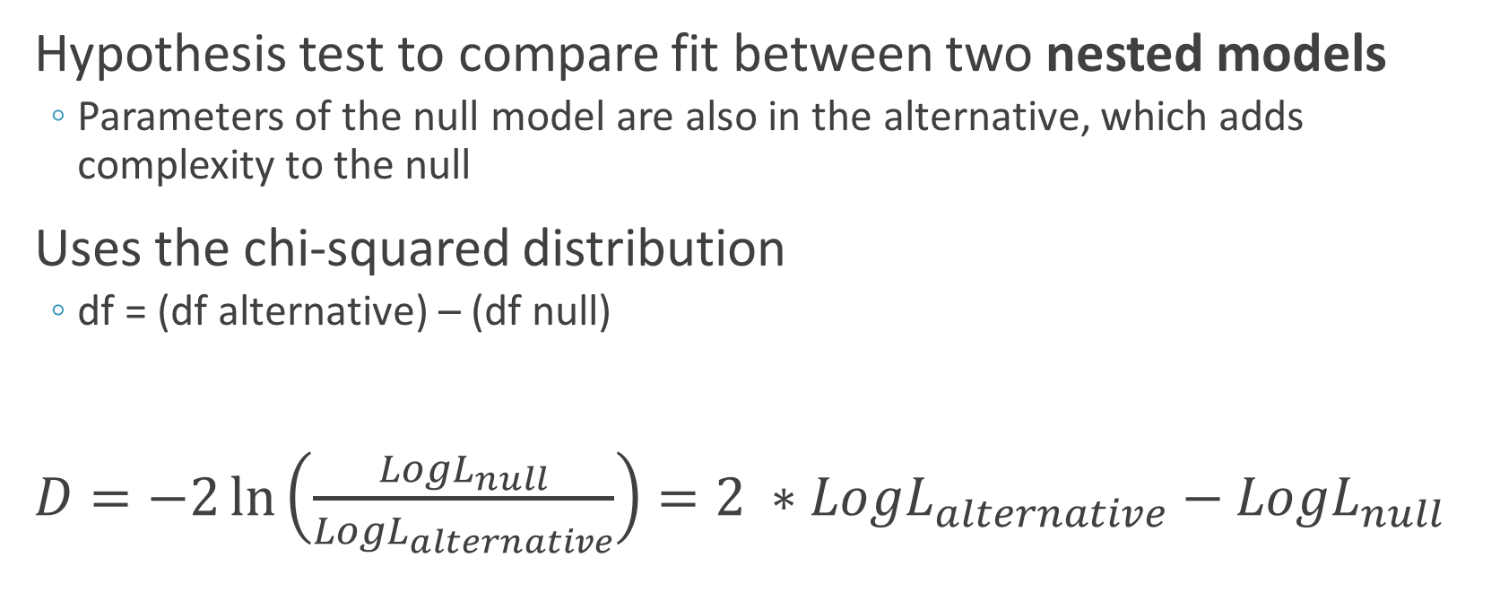
The likelihood ratio test (LRT)
Hypothesis test to compare fit between two nested models
Parameters of the null model are also in the alternative, which adds complexity to the null
Uses the chi-squared distribution
df = (df alternative) – (df null)
$D=−2\ln\left(\frac{{LogL}_{null}}{{LogL}_{alternative}}\right)=2 ∗{LogL}_{alternative}−{LogL}_{null}$

Slide 24

Performing a LRT
$$D=−2\ln\left(\frac{{LogL}_{null}}{{LogL}_{alternative}}\right)$$
$=2 ∗{LogL}_{alternative}−{LogL}_{null}$
> null_model <- lm(Sepal.Length ~ Petal.Length, data = iris)
> tidy(null_model) %>% select(term, estimate)
term estimate
1 (Intercept) 4.3066034150
2 Petal.Length 0.4089222774
> glance(null_model) %>% select( adj.r.squared, df, logLik)
adj.r.squared df logLik
1 0.7583327177 2 -77.02021159
> alt_model <- lm(Sepal.Length ~ Petal.Length + Species, data = iris)
> glance(alt_model) %>% select( adj.r.squared, df, logLik)
adj.r.squared df logLik
1 0.8333687938 4 -48.11637097
#### LRT #####
> D <- 2 * (-48.11637097 - -77.02021159) ### Comes out to 57.80768
> df <- 4 - 2
> 1 - pchisq(D, df)
[1] 2.799982468e-13
Y = 4.307 + 0.409X
→ The log likelihood of a model with estimated parameters 𝜷₀ = 4.307 and 𝜷₁ = 0.409 is -77.02
Evidence for model improvement in the alternative compared to the null.

Slide 25
LRT has very specific utility
Can only compare nested models
Can only compare two models
Not useful if I have 100 models and want to choose the "best" one
####### These are not appropriate for LRT #########
> null_model <- lm(Sepal.Length ~ Sepal.Width, data = iris)
> alt_model <- lm(Sepal.Length ~ Petal.Length + Species, data = iris)

Slide 26
Linear model selection and evaluation
Quantities of model fit (how well does my model fit the data?)
R²
Likelihood
Akaike Information Criterion (AIC)
Bayesian Information Criterion (BIC)
> model <- lm(Sepal.Length ~ Petal.Length, data = iris)
> glance(model)
r.squared adj.r.squared sigma statistic p.value df
1 0.7599546458 0.7583327177 0.407074548 468.5501535 1.038667419e-47 2
logLik AIC BIC deviance df.residual
1 -77.02021159 160.0404232 169.0723291 24.52503377 148

Slide 27


Comparing non-nested models
AIC and BIC take number of parameters into account to protect against overfitted models
$$AIC=2∗(k −LogL)$$
$$BIC=k∗log\left(n\right)−2∗LogL$$
k = number of parameters
n = sample size
BIC penalizes more strongly

Slide 28
Bias-variance tradeoff in model fitting

Slide 29
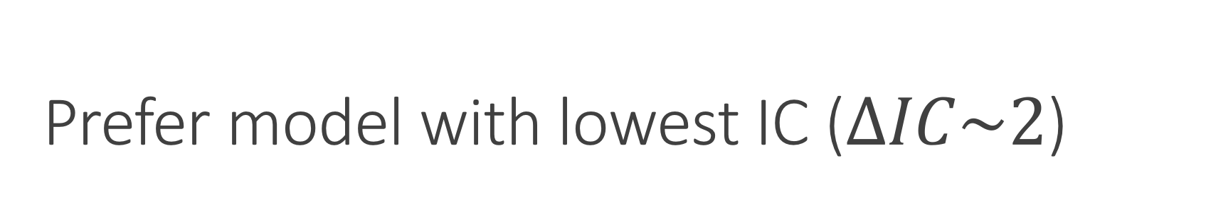
Prefer model with lowest IC ($ΔIC\sim 2$)
> model1 <- lm(Sepal.Length ~ Petal.Length, data = iris)
> glance(model1) %>% select( AIC, BIC)
AIC BIC
1 160.0404232 169.0723291
> model2 <- lm(Sepal.Length ~ Petal.Length + Species, data = iris)
> glance(model2) %>% select( AIC, BIC)
AIC BIC
1 106.2327419 121.2859184
> model3 <- lm(Sepal.Length ~ Petal.Length * Species, data = iris)
> glance(model3) %>% select( AIC, BIC)
AIC BIC
1 106.7673053 127.8417524
> model4 <- lm(Sepal.Length ~ Sepal.Width * Petal.Length * Species, data = iris)
> glance(model4) %>% select( AIC, BIC)
AIC BIC
1 80.40596946 119.5442283
With AIC, we prefer:
model4 >> model2 ~=model3 >> model1
With BIC, we prefer:
model4 >~ model2 > model3 >>model4

Slide 30
Exhaustive searching in R (one option of millions)
> model <- lm(Sepal.Length ~ ., data = iris)
### Selection with AIC
> aic.backwards <- step(model, trace=F) ## trace=F reduces output vomit
> aic.forwards <- step(model, trace=F, direction = "forward")
#### Selection with BIC
> bic.backwards <- step(model, trace=F, criterion = "BIC")

Slide 31
Exhaustive search results
> glance(aic.backwards)
r.squared adj.r.squared sigma statistic p.value df
1 0.8673122616 0.8627050485 0.3068261031 188.2509525 2.666942494e-61 6
logLik AIC BIC deviance df.residual
1 -32.55801067 79.11602135 100.1904684 13.55648508 144
> glance(aic.forwards)
r.squared adj.r.squared sigma statistic p.value df
1 0.8673122616 0.8627050485 0.3068261031 188.2509525 2.666942494e-61 6
logLik AIC BIC deviance df.residual
1 -32.55801067 79.11602135 100.1904684 13.55648508 144
> glance(bic.backwards)
r.squared adj.r.squared sigma statistic p.value df
1 0.8673122616 0.8627050485 0.3068261031 188.2509525 2.666942494e-61 6
logLik AIC BIC deviance df.residual
1 -32.55801067 79.11602135 100.1904684 13.55648508 144

Slide 32
Exercise break

Slide 33
It matters what data you use to build the model
> iris %>% sample_frac(0.2) -> iris.sub1
> iris %>% sample_frac(0.2) -> iris.sub2
> m1 <- lm(Sepal.Length ~ Petal.Length, data = iris.sub1)
> glance(m1) %>% select(r.squared)
r.squared
1 0.8522912784
> m2 <- lm(Sepal.Length ~ Petal.Length, data = iris.sub2)
> glance(m2)
r.squared
1 0.7443233142
> test.data <- tibble(Petal.Length = 8.7)
> predict(m1, test.data, interval = "confidence")
fit lwr upr
1 8.174451411 7.791955193 8.556947628
> predict(m2, test.data, interval = "confidence")
fit lwr upr
1 7.833587103 7.325629373 8.341544834

Slide 34
A model is only as good as the data used to train it

Slide 35
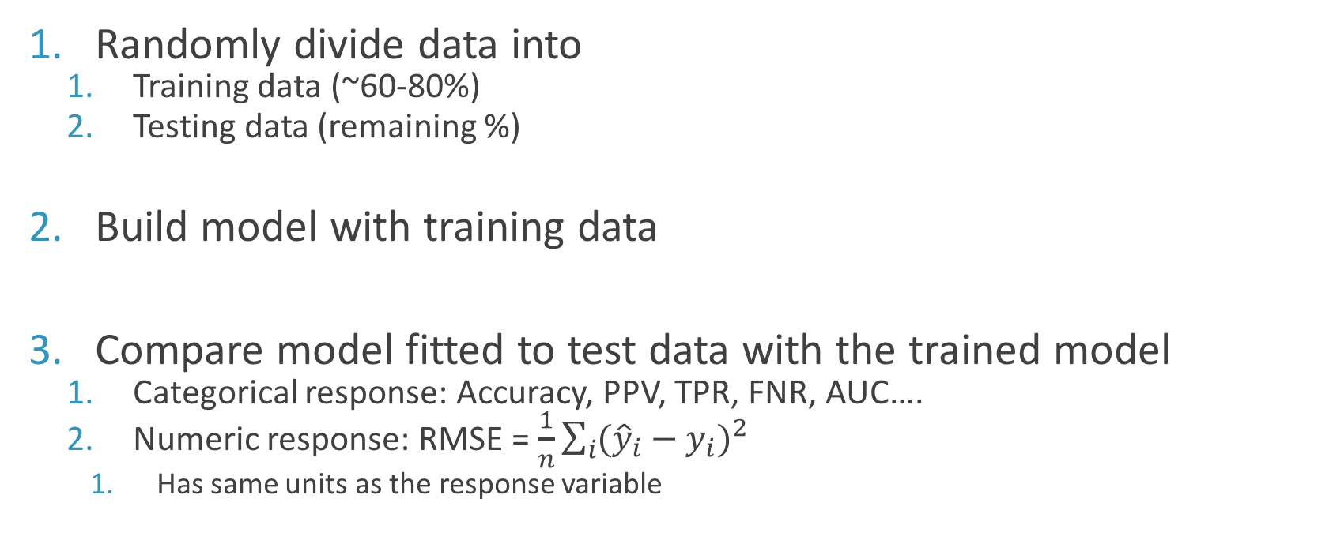
Model validation strategy: How predictive is my model?
Randomly divide data into
Training data (~60-80%)
Testing data (remaining %)
Build model with training data
Compare model fitted to test data with the trained model
Categorical response: Accuracy, PPV, TPR, FNR, AUC….
Numeric response: RMSE = $\frac{1}{n}\sum_{i}{{({\hat{y}}_{i}−y_{i})}^{2}}$
Has same units as the response variable

Slide 36
K-fold cross validation is common and powerful
Split data randomly into k evenly spaced chunks
K=10 is a good choice, K=5 for small datasets
Take first chunk as testing, and remaining chunks as training
Evaluate on test data
Repeat k times, so each chunk is used once as a test set
Note also:
LOOCV
MCCV

Slide 37
K-fold in action with modelr
## Create the K folds
> set.seed(27438)
> iris.folds <- modelr::crossv_kfold(iris, k=5)
> iris.folds
# A tibble: 5 x 3
train test .id
<list> <list> <chr>
1 <S3: resample> <S3: resample> 1
2 <S3: resample> <S3: resample> 2
...
## Train model on all training folds
> training.models <- purrr::map(iris.folds$train, ~lm(Sepal.Length ~ Petal.Length, data=.))
> ## Determine the RMSE between known test data Sepal Length and predicted Sepal Length from test data
> all.rmse <- purrr::map2_dbl(models, iris.folds$test, rmse)
> all.rmse
1 2 3 4 5
0.4307237 0.4518696 0.3807668 0.3743912 0.4135547

Slide 38
How are these errors?
> summary(all.rmse)
Min. 1st Qu. Median Mean 3rd Qu. Max.
0.3744 0.3808 0.4136 0.4103 0.4307 0.4519
> sd(all.rmse)
[1] 0.03285344
> summary(iris$Sepal.Length)
Min. 1st Qu. Median Mean 3rd Qu. Max.
4.300 5.100 5.800 5.843 6.400 7.900
> sd(iris$Sepal.Length)
[1] 0.8280661
Our model is fairly robust to the dataset used for construction and therefore is reliable.

Slide 39
We will do a single test/train set here
> iris.train <- iris %>% sample_frac(0.7)
> iris.test <- anti_join(iris, iris.train)
> iris.test.nosepal <- iris.test %>% select(-Sepal.Length)
> trained.model <- lm(Sepal.Length ~ Petal.Length, data = iris.train)
> test.predictions <- predict(trained.model, iris.test.nosepal)
> pred.and.true <- tibble(pred = test.predictions, true = iris.test$Sepal.Length)
> head(pred.and.true)
# A tibble: 6 x 2
pred true
<dbl> <dbl>
1 4.871385 4.9
2 4.912402 4.6
3 4.871385 5.0
...

Slide 40
Evaluating the model
> pred.and.true <- tibble(pred = test.predictions, true = iris.test$Sepal.Length)
### RMSE calculation, in response (Sepal.Length) units
sqrt(mean((pred.and.true$pred - pred.and.true$true)^2)))
[1] 0.3917498
### Why not, run a correlation too!
> cor(pred.and.true$pred, pred.and.true$true)
[1] 0.8802229
### And viz.
> ggplot(pred.and.true, aes(x = true, y = pred)) +
geom_point() + geom_abline(color="blue")
On average, our prediction error is 0.39

Slide 41
Test/train for logistic regression
> biopsy.train <- biopsy %>% sample_frac(0.7)
> biopsy.test <- anti_join(biopsy, biopsy.train)
> biopsy.test.nooutcome <- biopsy.test %>% select(-outcome)
> trained.model <- glm(outcome ~ ., data = biopsy.train, family=binomial)
### Predict on test and mutate into the full test data, biopsy.test
> predicted <- predict(trained.model, biopsy.test.nooutcome, type="response")
> biopsy.test %>% mutate(pred=predicted) -> biopsy.test

Slide 42
Compute various classifier metrics at 0.5 cutoff
> biopsy.test %>%
mutate(pred.malignancy = ifelse(pred > 0.5, "mal","benign")) %>%
group_by(outcome, pred.malignancy) %>%
tally()
# Groups: outcome [?]
outcome pred.malignancy n
<fctr> <chr> <int>
1 benign benign 51
2 benign mal 4
3 malignant benign 4
4 malignant mal 63
true negative
false positive
false negative
true positive
PPV = TP / (TP + FP) = 51/(51+ 4) = 0.927
Accuracy = (TP+TN) / (total) = (51 + 63) / (122) = 0.934

Slide 43
AUC calculations
> roc.train <- roc(biopsy.train$outcome, trained.model$linear.predictors)
> roc.train$auc
Area under the curve: 0.996
> roc.test <- roc(biopsy.test$outcome, predicted)
> roc.test$auc
Area under the curve: 0.9929

Slide 44
ROC curves for training and testing
> roc.data.train <- tibble(x = roc.train$specificities,
y = roc.train$sensitivities,
model = "train")
> roc.data.test <- tibble(x = roc.test$specificities,
y = roc.test$sensitivities,
model = "test")
> rbind(roc.data.train, roc.data.test) %>%
ggplot(aes(x=x, y=y, group=model,color=model)) + geom_line()+ scale_x_reverse()

Slide 45
Cross-validation
In an ideal world, perform this a bunch of times and examine distribution of your resulting metric to evaluate model performance

